Slide 1

Measuring Complexity a practical guide for Python and modern architectures
with Maxim Danilov

Slide 2
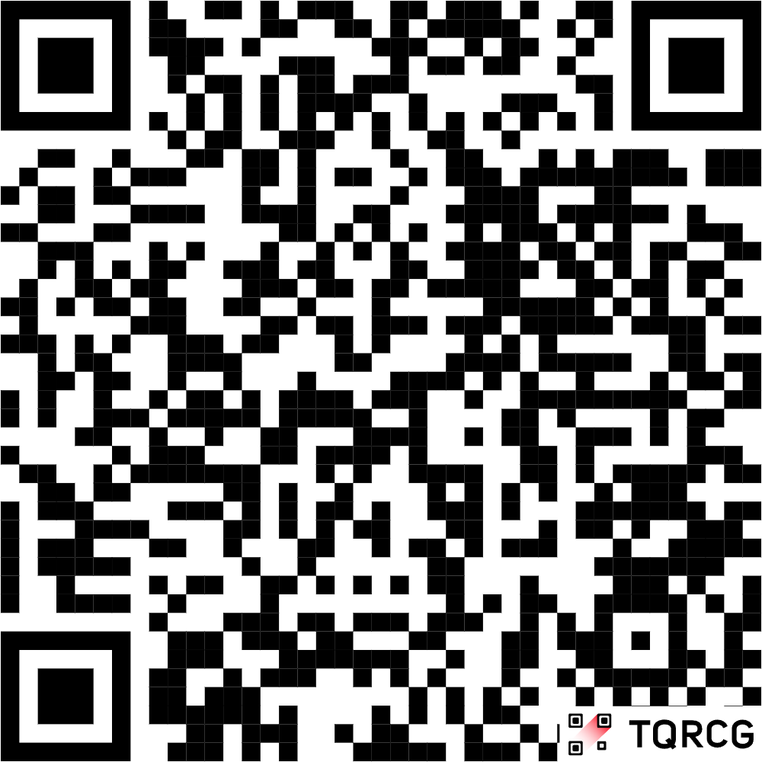
Who I am
Maxim
29 years in commercial software development
11 years with Python
9 years with reactive frontend frameworks.
I am a mentor for developers ADPlist.org

Slide 3
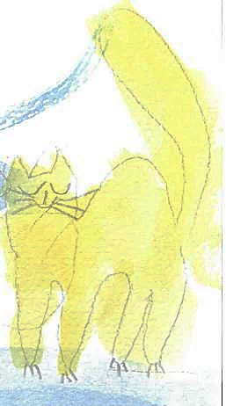



Special thanks to my family for the support:
cat
Kisa
daughter Maja
son
Mark
dog
Marselle
My wife
Elena

Slide 4

Thanks to my children Mark & Maja for the illustrations

Slide 5
Disclaimer

Slide 6
All talks about Software Complexity are:
completely Subjective
And we don’t have any clear objective metrix

Slide 7
All talks about Software Complexity are:
completely Subjective
.

Slide 8
Complexity
What, where, why

Slide 9
Arts of complexity
Cognitive
Accidental
Structural
Essential

Slide 10
Technical (essential) Complexity
Present choosen technology / algorythm. (part of the code as a irreducible block)
Exists as is, can not suddenly appear or dissapears.
Reflected through Big O notation (Matematical Complexity).
Measurements: CyC (Mackabe index), big_O metrix.

Slide 11
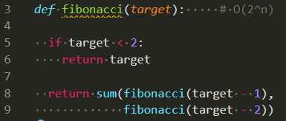
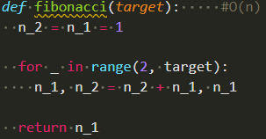
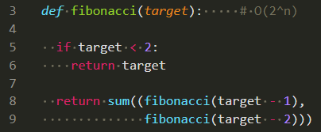
Example:
O (n)
O (2^{n})

Slide 12
Structural Complexity
Relations between parts in projects. Reflect Applyed programming patterns, Project organizing.
Affected on strict Project design.
Appears by premature optimisation, breaking YAGNI, or overeinginiering by following SOLID
Measurements: Mi, C/m or functions counts, Dep‘s index…

Slide 13
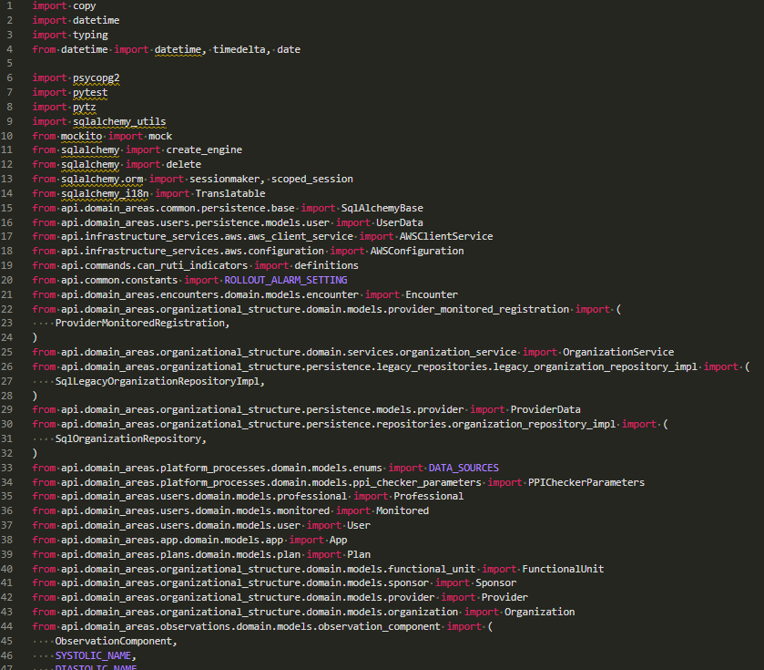
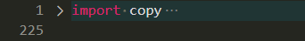
Example
168 imported objects in 131 import lines
Django/db/models/functions/__init__.py :
91 imported object in 6 lines
FastAPI/dependencies/utils.py:
68 object imported in 20 lines.

Slide 14
Cognitive complexity
Readability
Understandability, ability to reproduce again
Affected by code styleguides, correct comments, documentation,
Strictly Human oriented metrix
Measurements: halstead Metrix, Sonar CgC, DocCoverage

Slide 15
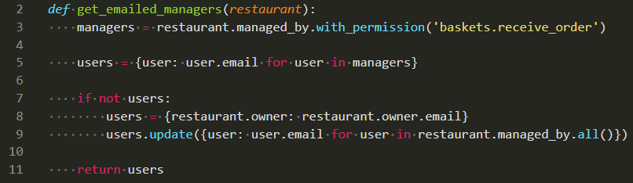
Example:

Slide 16
Example:

Slide 17
Example:

Slide 18
Accidental Complexity
Compromisses dues Unaligned codeparts
MVP converted to permanent solution.
Affected on strict Schemas and specifications.
More appears in startup/ AI-assisted projects. Increases implicitly.
Measurements: unusual activity and Code churns in local places.

Slide 19
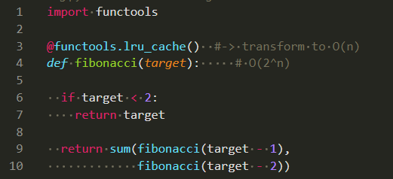

Example:

Slide 20
Metrix of Complexity
From obivious to rare

Slide 21
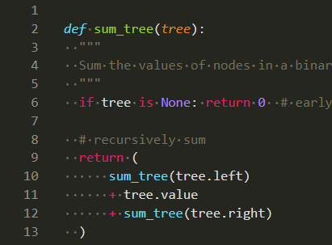
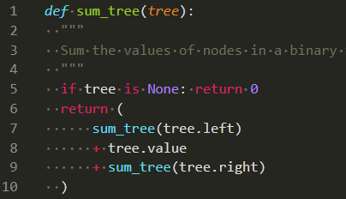
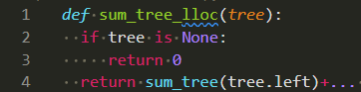
LOC, SLOC, LLOC – general metrix
LOC
Code itself
Reality 🥺
SLOC
Cleaned source code
Used in Metrix 🤓
LOC
Source code
To share it for all 😎

Slide 22
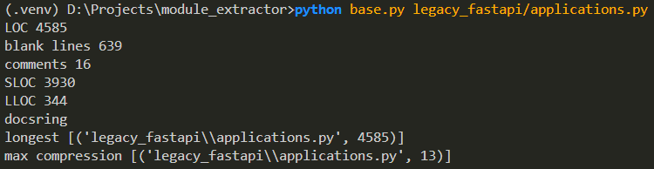
LOC, SLOC, LLOC – example:
git clone https://github.com/danilovmy/dependency-extractor

Slide 23
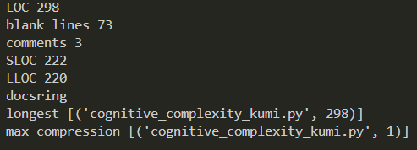
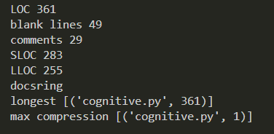

LOC, SLOC, LLOC – 🤖 vs 🧑:
🤖
🧑

Slide 24
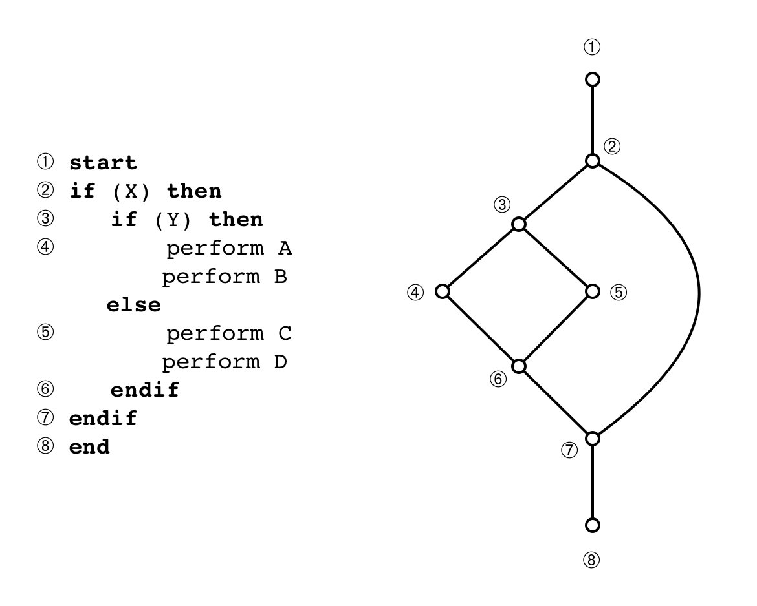
McCabe index (TC)
Reflexed quantity of decision points.
Give penalty for every logical structure.
Forces to use less effective constructions To achieve better results.
Can be used in prompts:
„write a code with CyC less than 10“

Slide 25
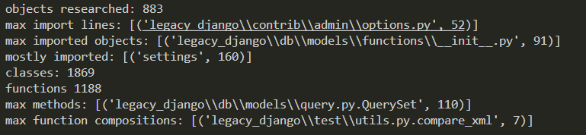
Class / Func index (TC, SC)
> python stats.py legacy_django -r
Anemic Classes, God Classes and Heavy function compositions.
Programming paradigm (61% Cb vs 39%Fb)
- Broken by functions composition
- Pytest/Unittests should not be counted.

Slide 26
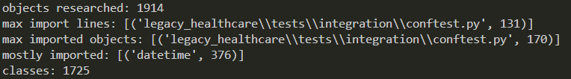
Dependency Index (SC)
Coupling/Cohesion index.
> python stats.py legacy_healthcare -r
- dynamic imports are not included.

Slide 27
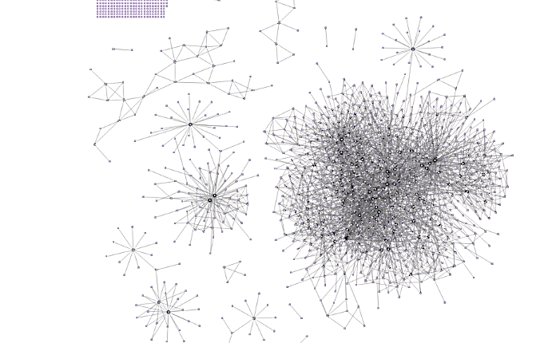

Dependency Index (SC)
NanoAPI visual maps

Slide 28
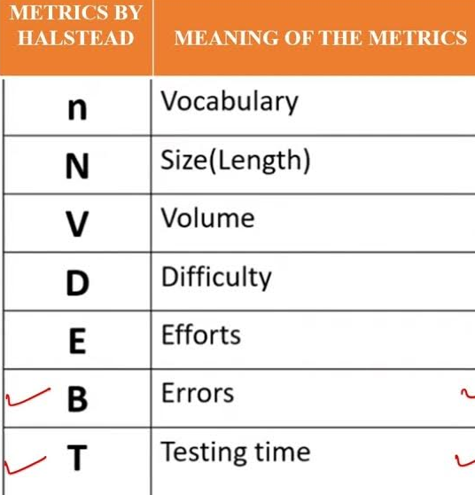
Halstead Metrix, (CC)
Reflexed readability of code as a text
Give small penalty for every name
Give hard penalty for every statement
Give hard penalty for every operator
Forces to apply DRY on maximum.

Slide 29
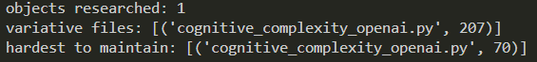
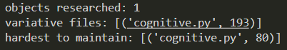

Halstead Metrix 🤖 vs 🧑:
🤖
🧑
AI generated code have bigger vocabulary, yet.

Slide 30
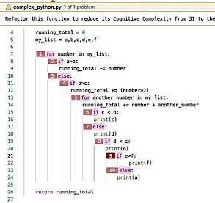
Cognitive Complexity Index (CC)
Presented in 2017 by Sonar (SonarCloud).
Mutated from CyC,
Give penalty for code contructions
Give hard penalty for nested blocks
Forces to write plain code.
- not adopted for python, calculated wrong even in Sonar.

Slide 31
Maintainability Index (AC)
Created by Software Engineering Institute in 1997
171 - 5.2*ln(Hal) - 0.2*Cycl - 16*ln(SLOC) + 50*sin(sqrt(2*Comments))
Index value | Color | Meaning
0-9 | Red | Low maintainability of code
10-19 | Yellow | Moderate maintainability of code
20-100 | Green | Good maintainability of code

Slide 32
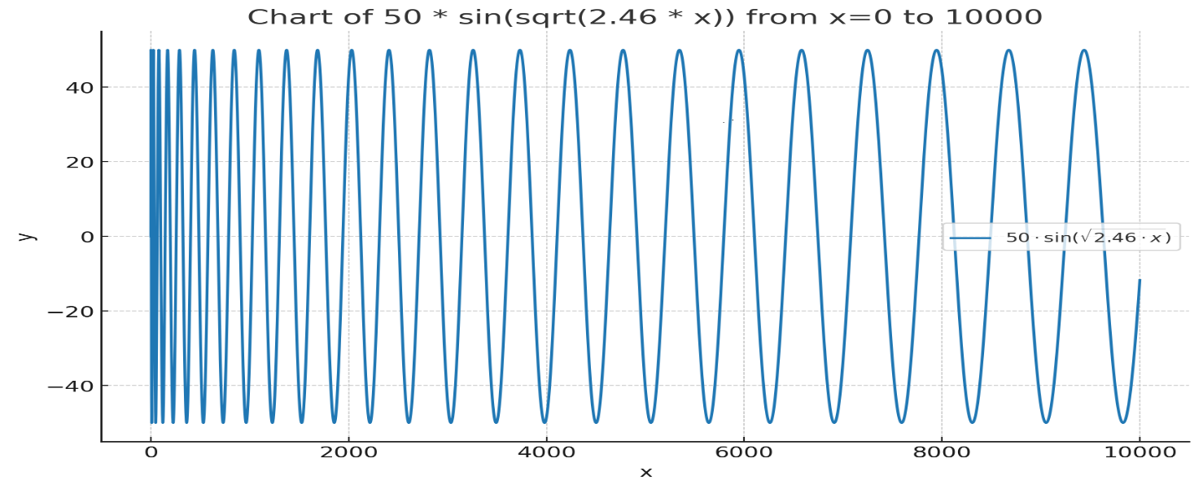
Maintainability Index depends on comments
Implemented by Radon, SonarQube, Microsoft Visual Studio, Wily, ProjectCodeMeter…

Slide 33
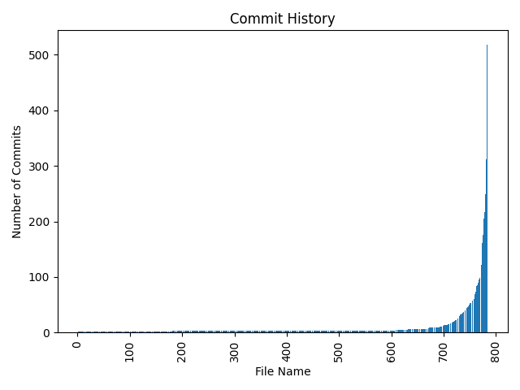
Acsidential Complexity (AC)
„Changed code concentrate AC“
Code churns metrix,
project «heat» maps.
Shows what should be 100% tested

Slide 34
Working with Complexity
Fight with invisible enemy

Slide 35
Golden rule:
Requirements for Complexity handling should be reflected on business level.

Slide 36
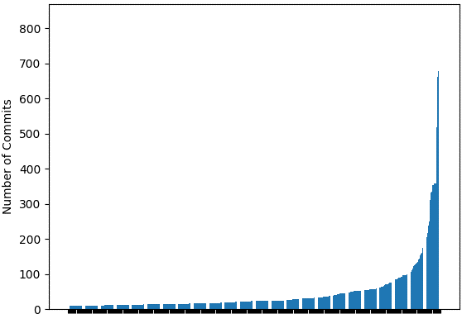
Defining refactoring Hot Zones
Only few files change often (Feathers)
Some files must be clean,
Ignore the rest (Fowler)
20% changes affect on 80% results
(pareto)
Refactoring steps
should be done there

Slide 37
Watching Complexity
Points of concentrated complexity can be located easy.
Only Watching complexity metrix through the time help to detect complexity grow.
Define treshhold complexity metrix for Hot Zones on the current state and watch, what happens.

Slide 38
Complexity
Recup and homework

Slide 39
Last words about measuring tools
Radon. Not works with type annotated dataclass’es
Sonar cloud. Due language agnostic works not well with python code.
AIkido, code quality measurements not works.
All services builded on radon (xenon, willy, CodeClimate, Codacy…) works not correctly.
That’s why I have created my own tools

Slide 40
Complexity recup
It is normal
Can be find only in comparance before – after
Should be handled on the same level as documentstion or code testing.
Is completely subjective!

Slide 41
Try it at home.
Chooze a project.
Find a Zero tech debt zone.
Find in this zone Compexity points (AC, CgC, SC)
Find a file with statistically biggest complexity / higer compression.
Try to improve it.
Enjoy. After repeate.

Slide 42
Time to refactor questions to ansvers.
Maxim Danilov maxim@wpshop.at
Repo: github.com/danilovmy/dependency-extractor

Slide 43
Related links
https://github.com/rubik/xenon/blob/master/xenon/core.py
https://radon.readthedocs.io/en/latest/commandline.html#radon-configuration-files
https://stackoverflow.com/questions/52741725/what-is-cognitive-complexity-in-sonar-report
https://dev.to/optiklab/writing-self-documented-code-with-low-cognitive-complexity-3k2l
https://blog.devgenius.io/sonarqube-cognitive-complexity-265640dbad3e
https://medium.com/@himanshuganglani/clean-code-cognitive-complexity-by-sonarqube-659d49a6837d
https://rohaquinlop.github.io/complexipy/
https://github.com/Melevir/cognitive_complexity/blob/master/tests/test_cognitive_complexity.py
https://github.com/rohaquinlop/complexipy/blob/main/src/cognitive_complexity/mod.rs
https://github.com/ganncamp/cognitive-complexity/blob/master/src/main/java/com/sonarsource/rules/java/checks/CognitiveComplexityCheck.java
https://community.sonarsource.com/t/cognitive-complexity-calculation-for-a-file-project/108367
https://www.sonarsource.com/blog/5-clean-code-tips-for-reducing-cognitive-complexity/
https://www.youtube.com/watch?v=x5V2nvxco90
https://www.youtube.com/watch?v=el9OKGrqU6o
https://www.sonarsource.com/docs/CognitiveComplexity.pdf
https://wemake-python-styleguide.readthedocs.io/en/1.0.0/pages/usage/violations/complexity.html
https://swimm.io/learn/developer-experience/how-to-measure-code-churn-why-it-matters-and-4-ways-to-reduce-it
https://github.com/astral-sh/ruff/discussions/20699
https://medium.com/@stevekowalski_47184/software-complexity-is-it-worth-measuring-98fba5244261
https://speakerdeck.com/matthiasmullie/software-metrics?slide=17

